Slide 1
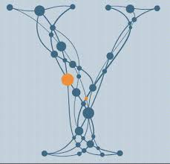
Identifying Spoofing in Financial Markets
Yins Datahack Group 9
Xuefei Yang, Guoling Liu, Soheil Eshghi, Setareh Maghsudi

Slide 2
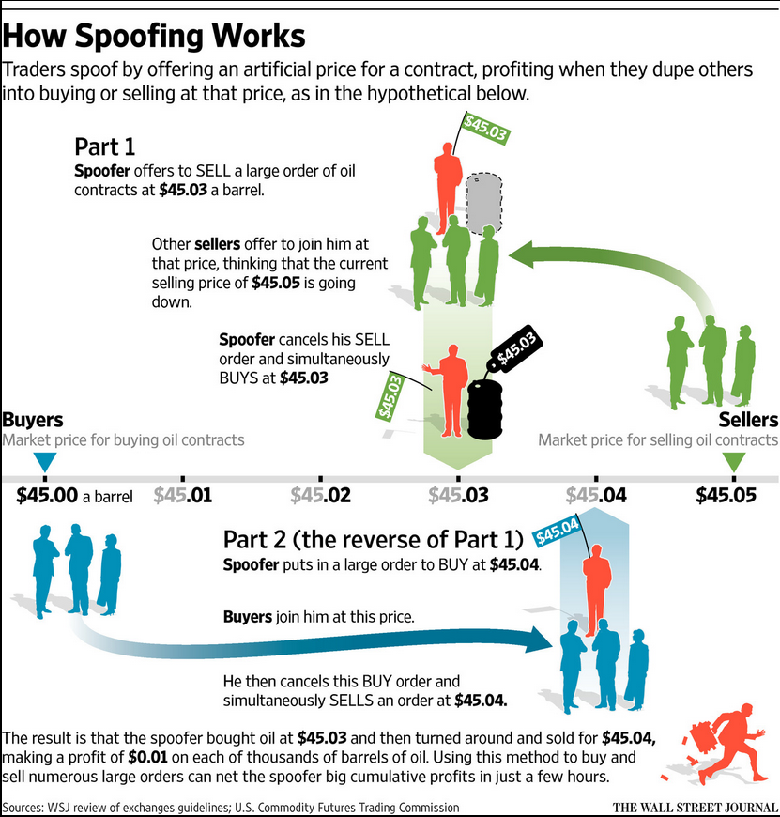

Group Spoofing and Goldman Sachs Dataset
Spoofing: Canceling fake orders to manipulate stock prices
PGSA: Simultaneous Communication + Trades
Data-set:
100 timestamps
2 datasets per timestamp: communication and trades
~50,000 rows per trade data-set
Communication D/S: 2 columns
Trade D/S: 4 columns

Slide 3
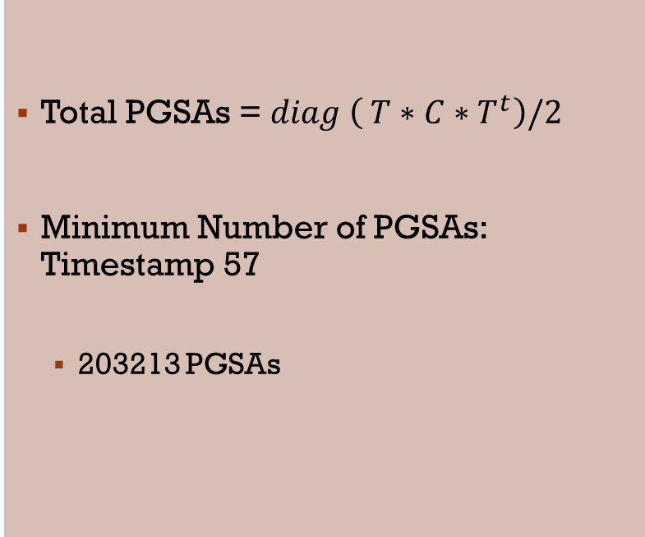
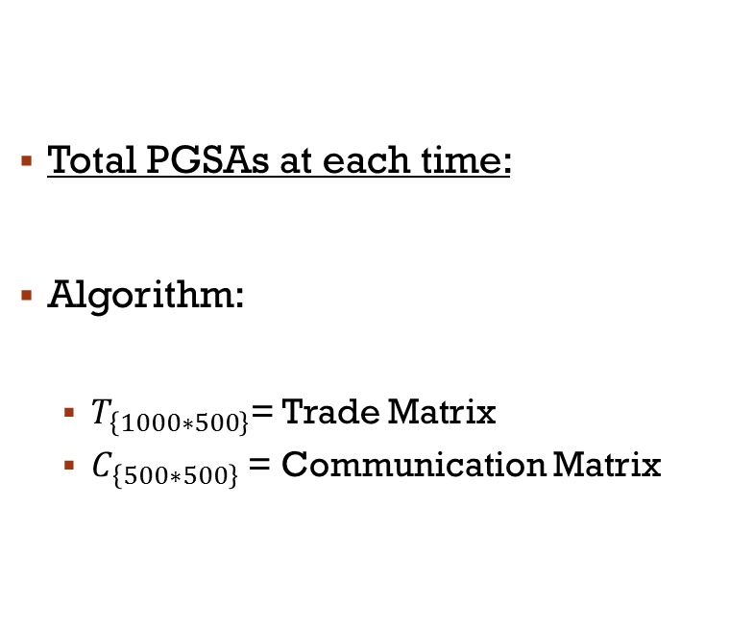
Detecting PGSAs
Total PGSAs at each time:
Algorithm:
$T_{\left\{1000∗500\right\}}$= Trade Matrix
$C_{\left\{500∗500\right\}}$ = Communication Matrix
Total PGSAs = $diag \left( T∗C∗T^{t}\right)/2$
Minimum Number of PGSAs: Timestamp 57
203213 PGSAs

Slide 4
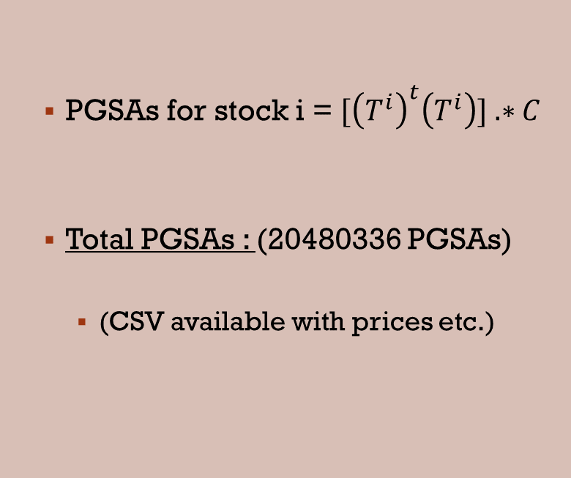
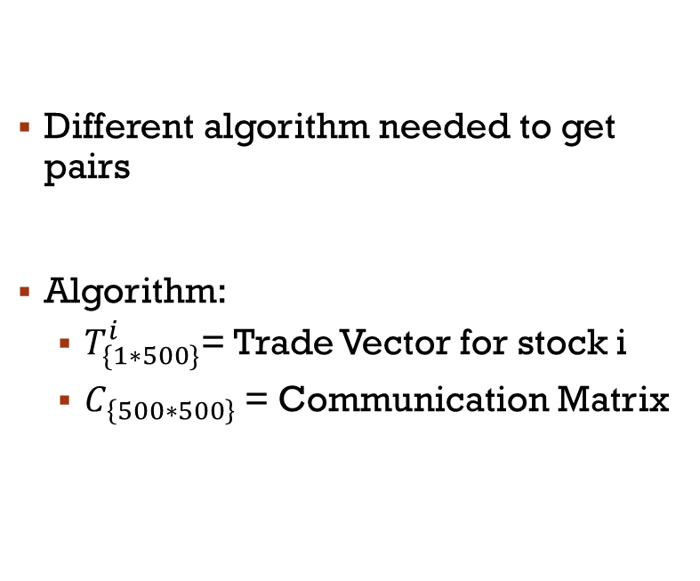
Finding All PGSAs
Different algorithm needed to get pairs
Algorithm:
$T_{\{1∗500\}}^{i}$= Trade Vector for stock i
$C_{\left\{500∗500\right\}}$= Communication Matrix
PGSAs for stock i = $[{\left(T^{i}\right)}^{t}\left(T^{i}\right)] .∗C$
Total PGSAs : (20480336 PGSAs)
(CSV available with prices etc.)

Slide 5

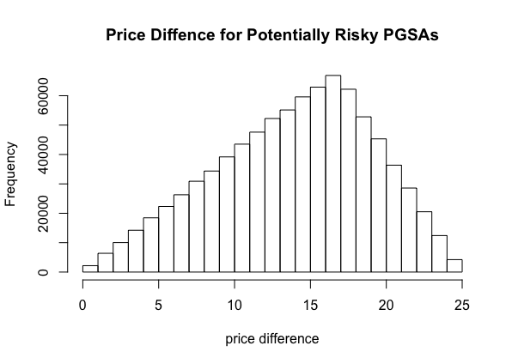

What is the riskiest PGSA?
Risk of a PGSA: likelihood that PGSA is spoofing.
How can it be measured?
Assumption 1: Spoofing only happens on BUY/SELL pairs
Assumption 2: Spoofing may only occur when price spread (difference between sell and buy price) is small across PGSA
We assume 50% spread is threshold for unlikely spoofing attempts
Total potentially risky PGSAs = 854708 PGSAs
Riskiest PGSA pair:
Traders 435 & 470 @ T=14
Traders 435 & 475 @ T=14
Both stock 565

Slide 6


Hypotheses: ____ is related to spoofing risk
Hypothesis | Analysis
More PGSAs at timestamp ~ riskiness
Different timestamps ~ different riskiness
More total trading in a timestamp ~ riskiness
More total shared trades between traders ~ riskiness
Higher between-ness centrality of a PGSA edge ~ riskiness
Sign of the price difference ~ different riskiness
Centrality of trader in PGSA graph | ?

Slide 7
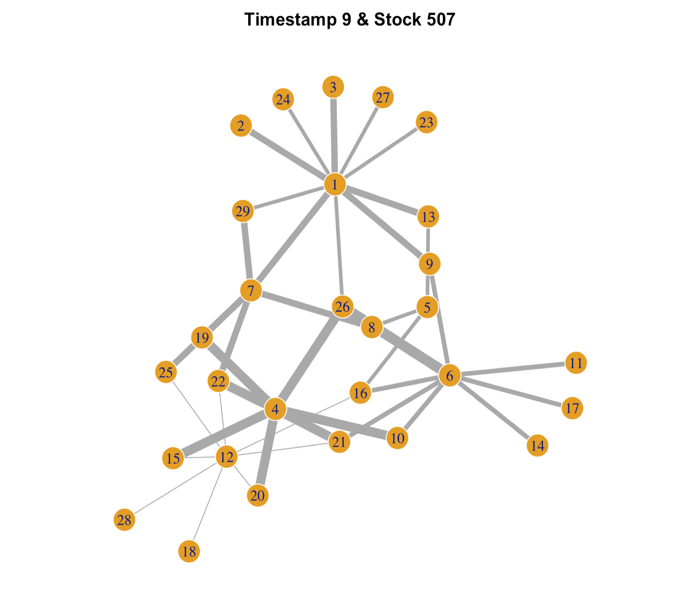
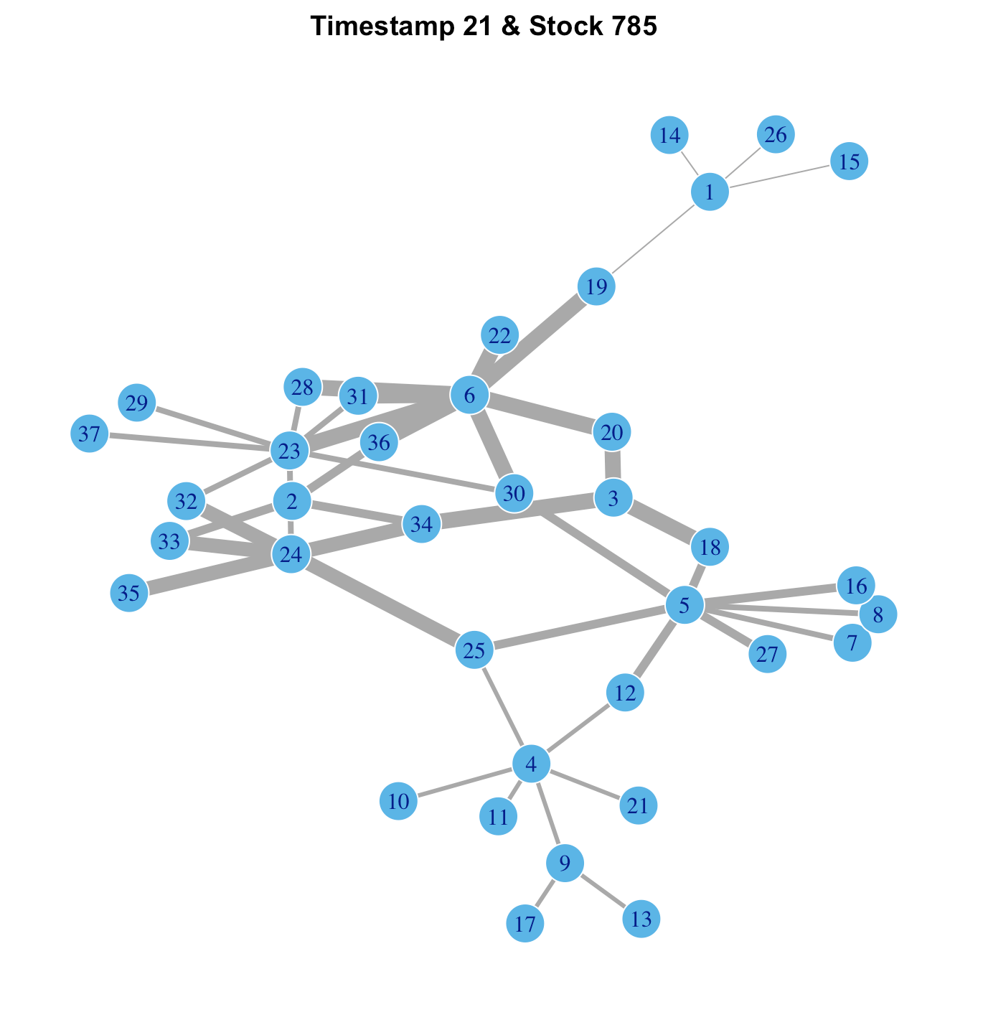
PGSA Networks (I)

Slide 8
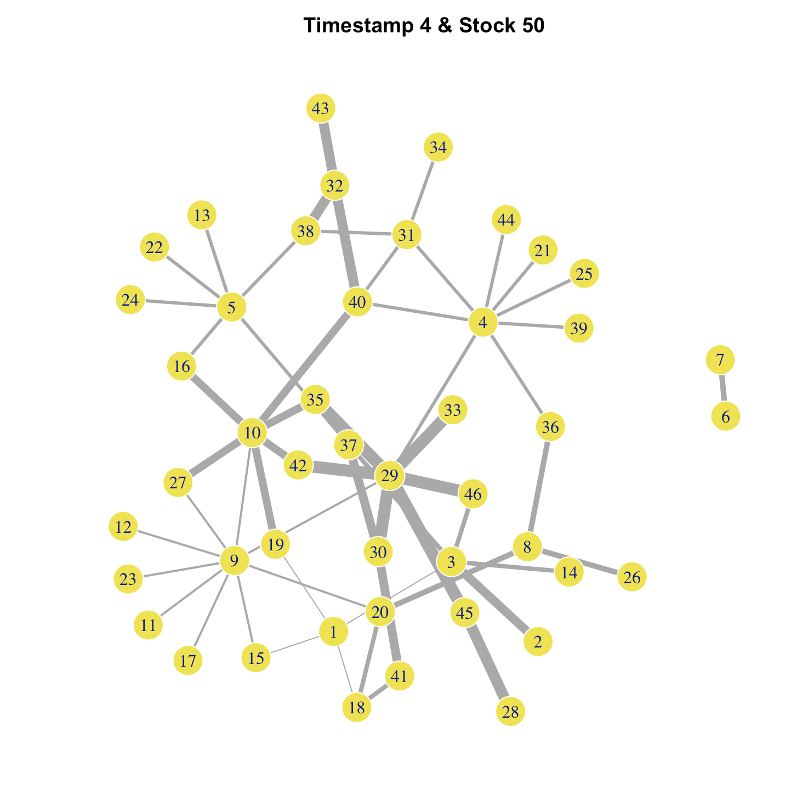
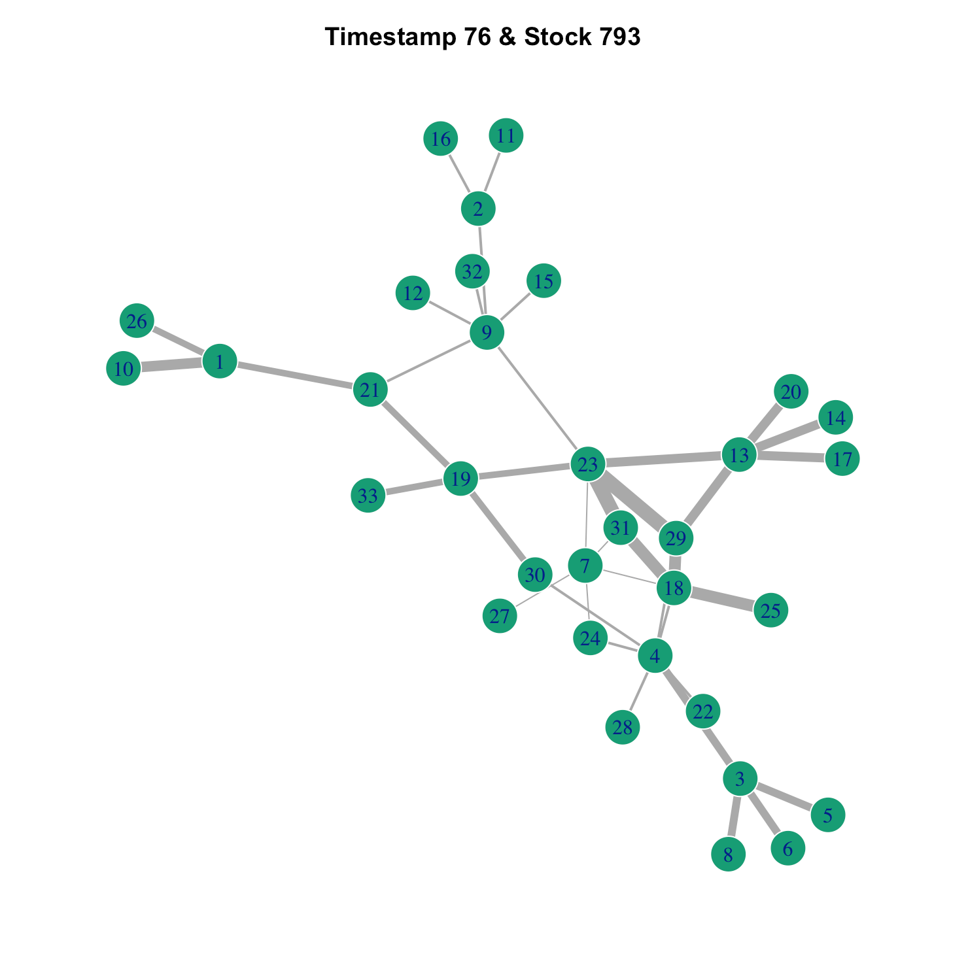
PGSA Networks (II)

Slide 9
Any Questions?
Thank you!

